Slide 1





Customer-100 Dataset
Team :
Name: Sejal Abhaykumar Kothali
Email: sejalkothali2003@gmail.com Guide:
Disclaimer: The content is curated for educational purposes only.
Notes:
Slides: Prepare a short slide deck (10-12 slides) summarizing the project objectives, methodology, and key results.

Slide 2
OUTLINE
Abstract of the Project
Problem Statement
Proposed Solution
System Architecture
Live Demo of the Project
Embedded Video of Project
Conclusion
Future Scope

Slide 3
Abstract
Exploring the Data: Looking at the trends and patterns in customer details and what they buy.
Grouping Customers: Using methods to divide customers into groups based on their behavior and characteristics.
Predicting Future Behavior: Creating models to predict things like whether customers might leave or what they are likely to buy.
Finding Key Insights: Understanding what factors drive high-value customers and regular buyers.

Slide 4
Problem Statement
Data Analytics on Customer-100 Dataset

Slide 5
Proposed Solution
Targeted Marketing Campaigns:
Solution: Use customer segmentation to create personalized marketing campaigns that focus on the most valuable customer groups.
Customer Retention Strategies:
Solution: Implement retention programs for high-risk customers based on predictive models that identify those most likely to churn.
Improved Customer Experience:
Solution: Focus on enhancing the shopping experience for specific customer segments that show potential for higher lifetime value.
Upselling and Cross-Selling:
Solution: Identify customers with a high likelihood of purchasing complementary products and suggest these items during the shopping experience.

Slide 6
System Architecture
Data Collection Layer
The Customer-100 dataset (could be collected from various sources like CRM systems, transactional databases, etc.).
Includes demographic data (e.g., age, gender, location) and behavioral data (e.g., purchase history, frequency of visits).
Data Storage Layer
The dataset is stored in a relational database (e.g., MySQL, PostgreSQL) or a data warehouse (e.g., Amazon Redshift, Google Big Query) for easy access and management.
Regular backups are taken to prevent data loss and ensure data integrity
Data Preprocessing Layer
Handle missing values, duplicates, and outliers to ensure the data is consistent and accurate.
Normalize, scale, or encode data (e.g., converting categorical data into numeric format using one-hot encoding).
Creating new features that may help in analysis, such as categorizing customer spending levels (high/medium/low).

Slide 7
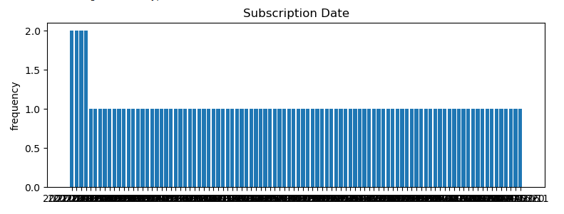
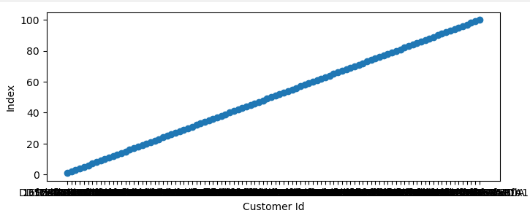
Live Demo of Project
Scatter plot
Bar plot

Slide 8
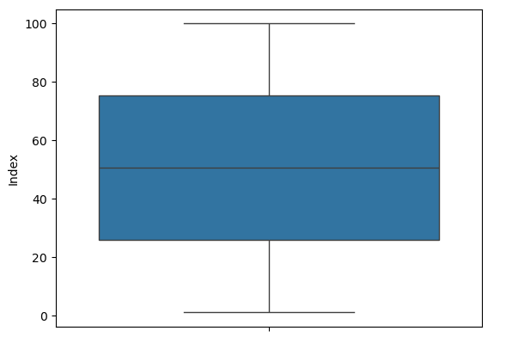
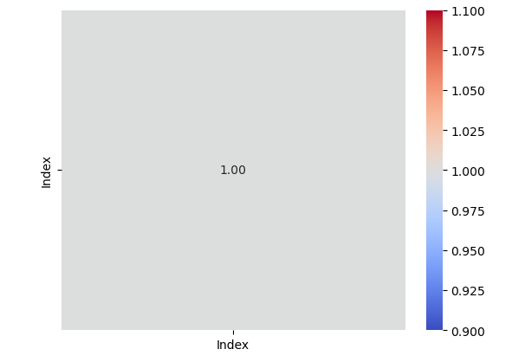
Video of Project Demo
Box plot
Hetmap plot

Slide 9
Conclusion
In conclusion, the analysis of the Customer-100 dataset offers valuable insights into customer behavior, preferences, and purchasing patterns.
The segmentation of customers and the development of predictive models allow for targeted marketing, improved customer retention, and optimized product offerings.

Slide 10
Future Scope
Expand the dataset by adding more customers to gain better insights and make the analysis more generalizable.
Implement recommendation engines using collaborative filtering or content-based filtering to suggest products based on customer preferences.
Implement real-time data collection and processing from various customer touchpoints (website, mobile app, social media).
Use more advanced unsupervised learning techniques like deep learning-based clustering methods (e.g., auto encoders) for more granular segmentation.

Slide 11
Thank you!
Notes:
thank you very much for joining this PPT, keep learning.
11

